Slide 1

Deep Learning
Stan Z. Li, Tao Lin
Lecture 13: Generative Models
Stan Z. Li

Slide 2
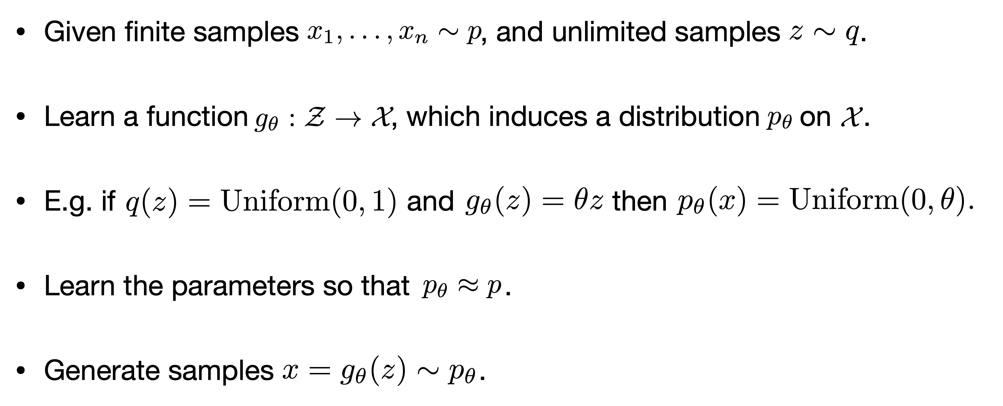
Generative Modeling

Slide 3
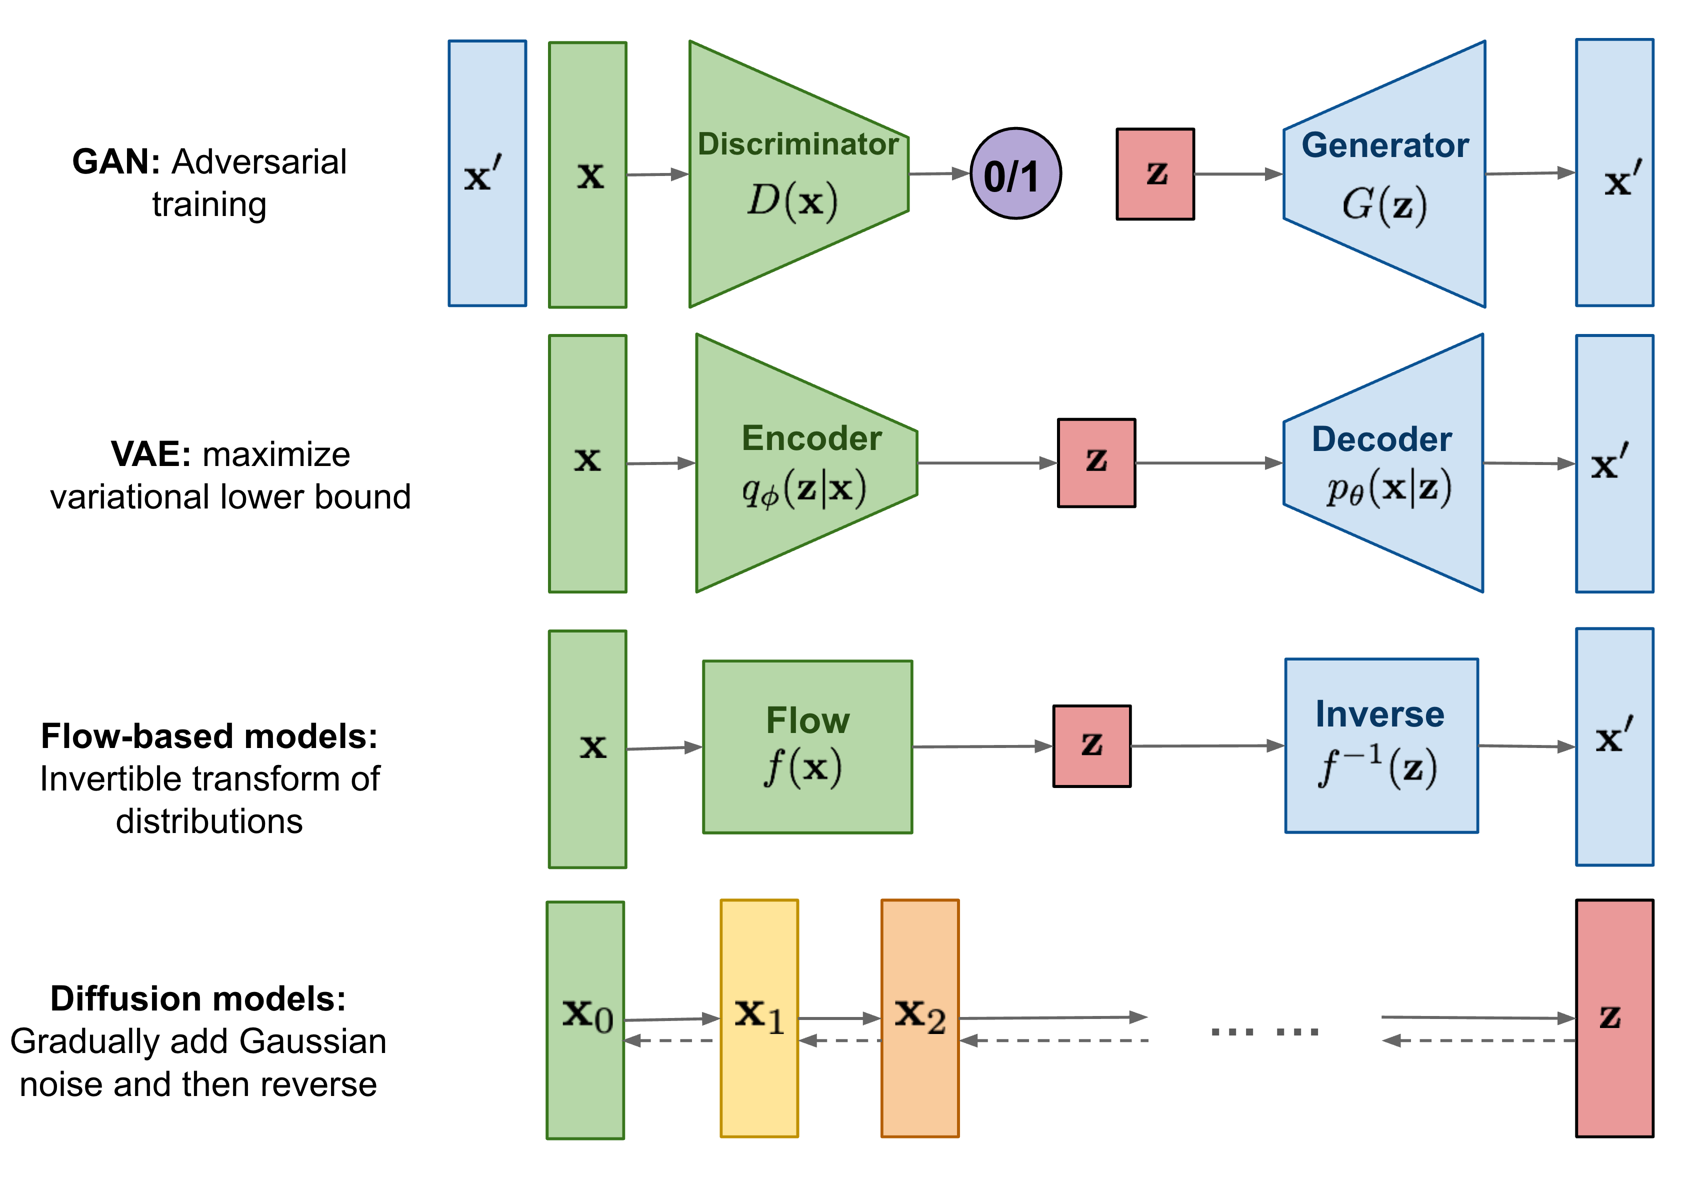
Generative Models

Slide 4
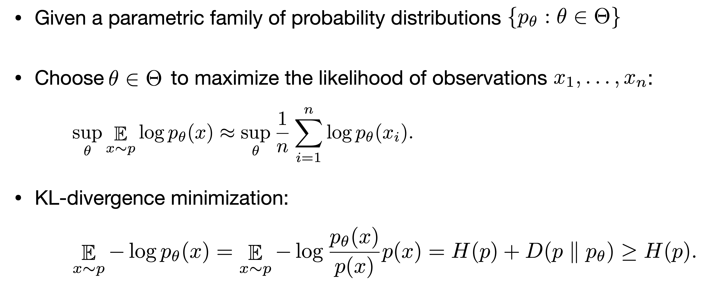
Maximum Likelihood Estimation

Slide 5
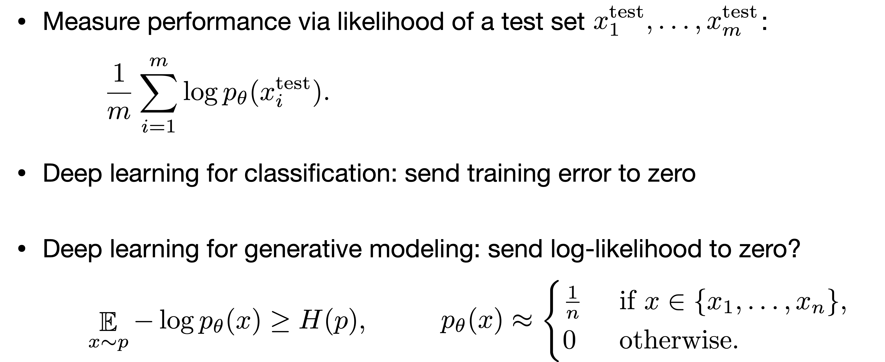
Generalization

Slide 6
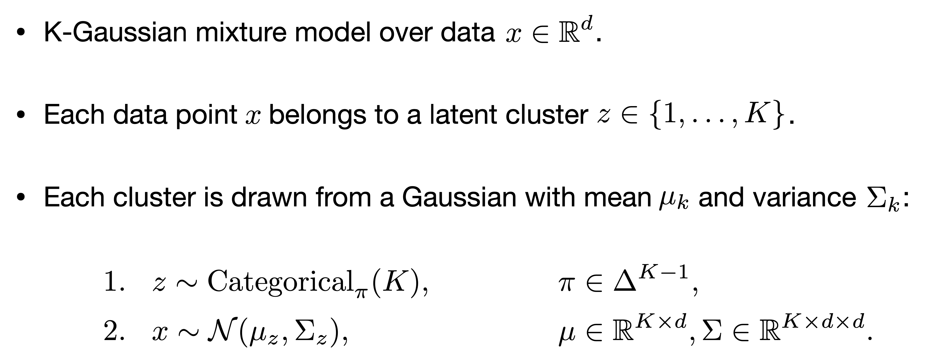
Gaussian Mixture Models

Slide 7
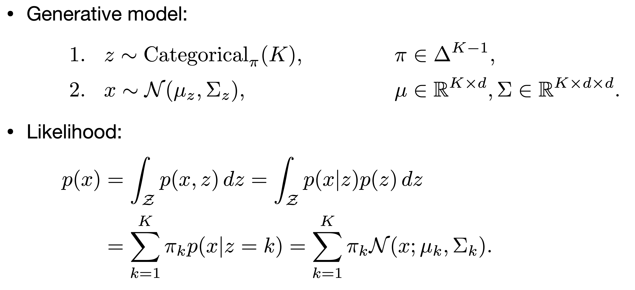
Gaussian Mixture Models

Slide 8
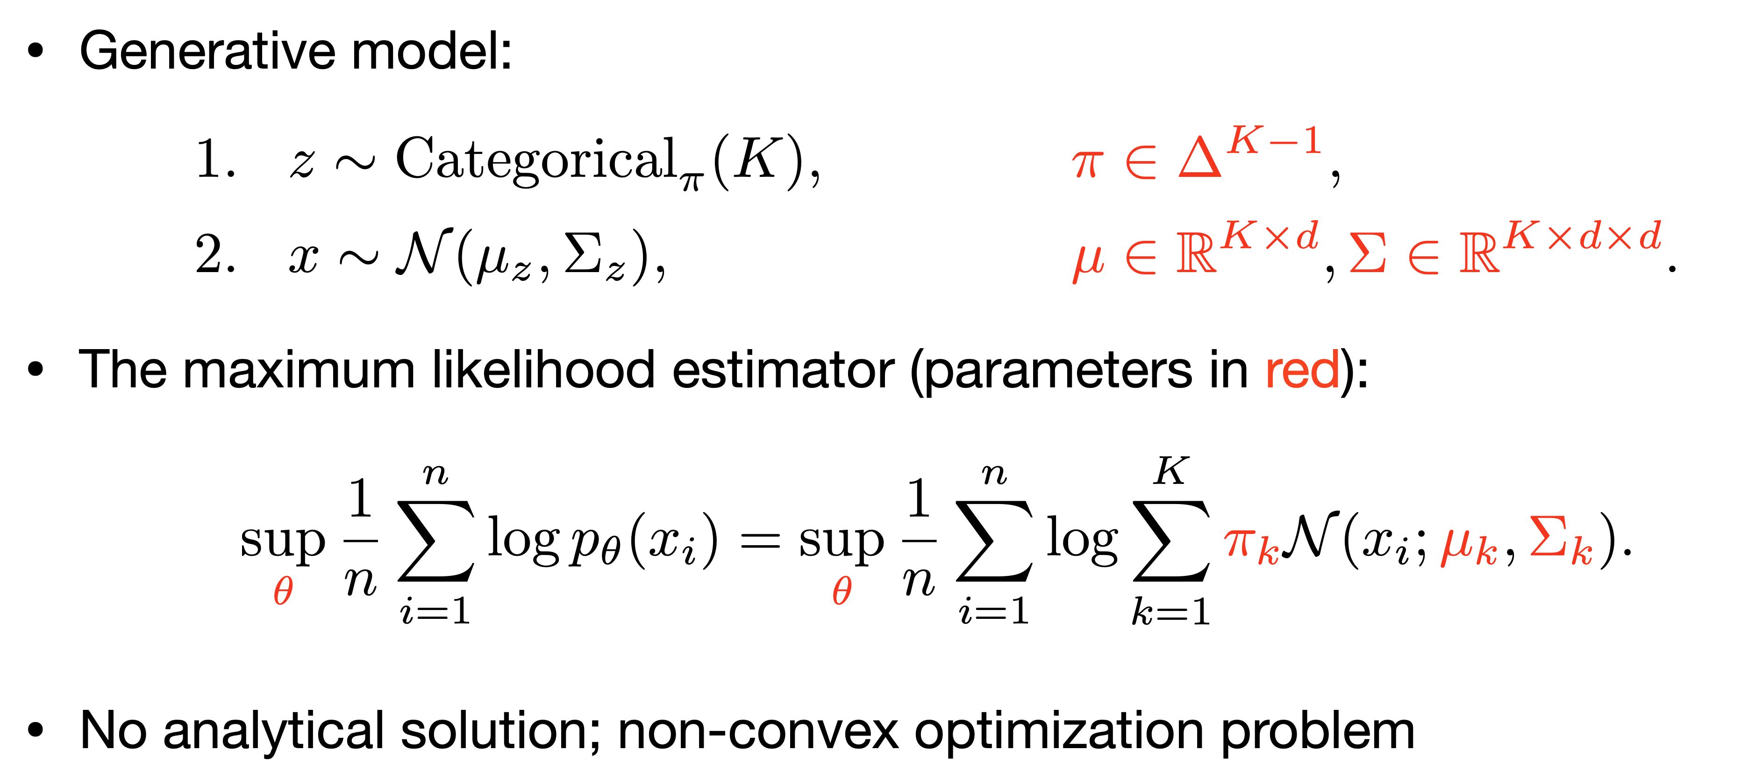
Maximize the Likelihood

Slide 9
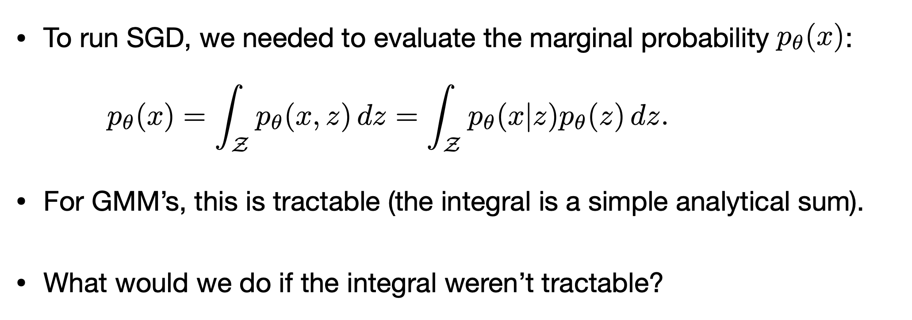
Recap: Evaluating the Likelihood

Slide 10
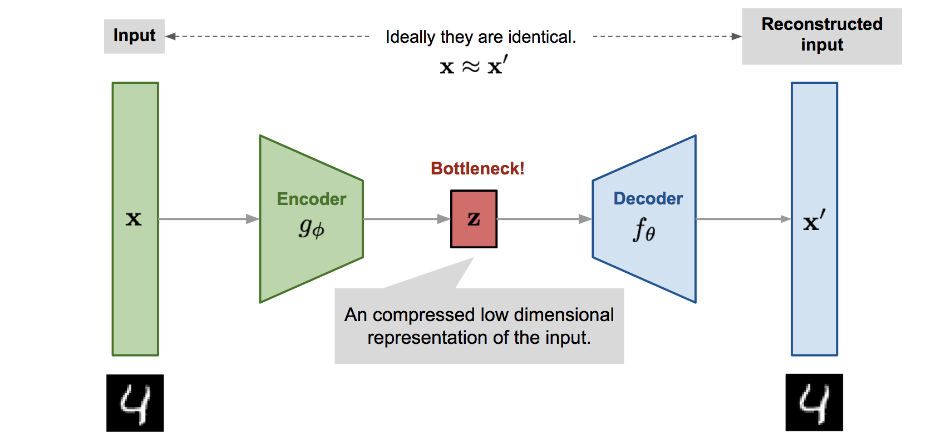
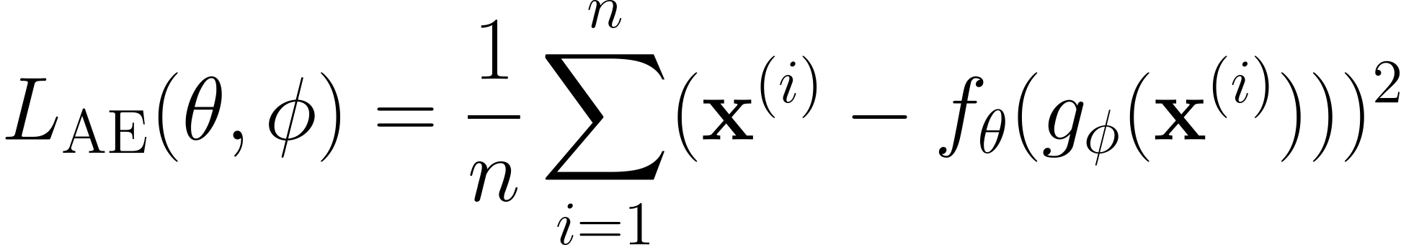
Autoencoder
Represent the data distribution in the latent space

Slide 11
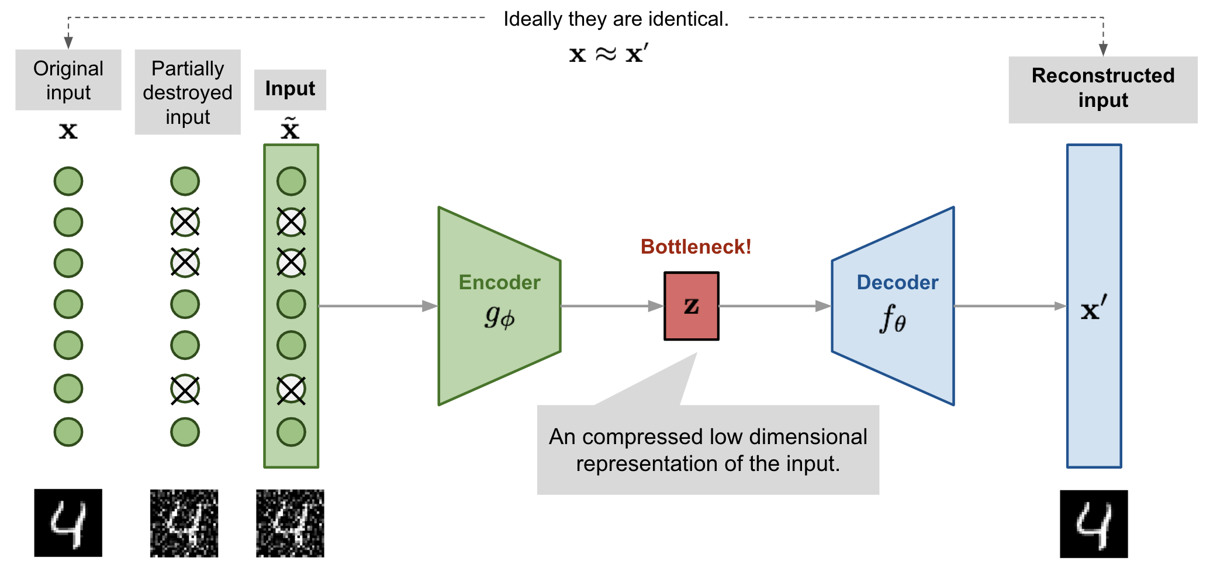
Denoising Autoencoder

Slide 12
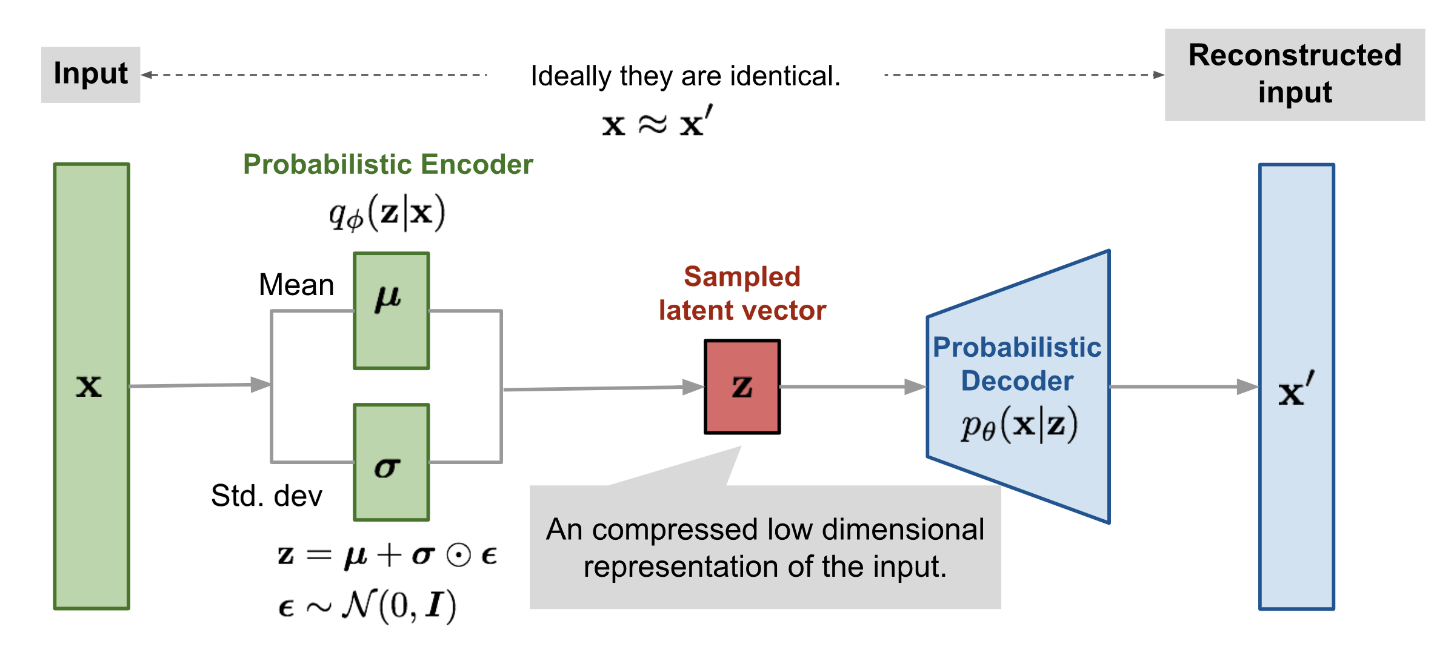

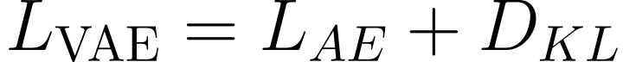
Variational Autoencoders
Represent the data distribution with Gaussian
intractable
Final Loss:
Optimize the lower bound (ELBO)

Slide 13
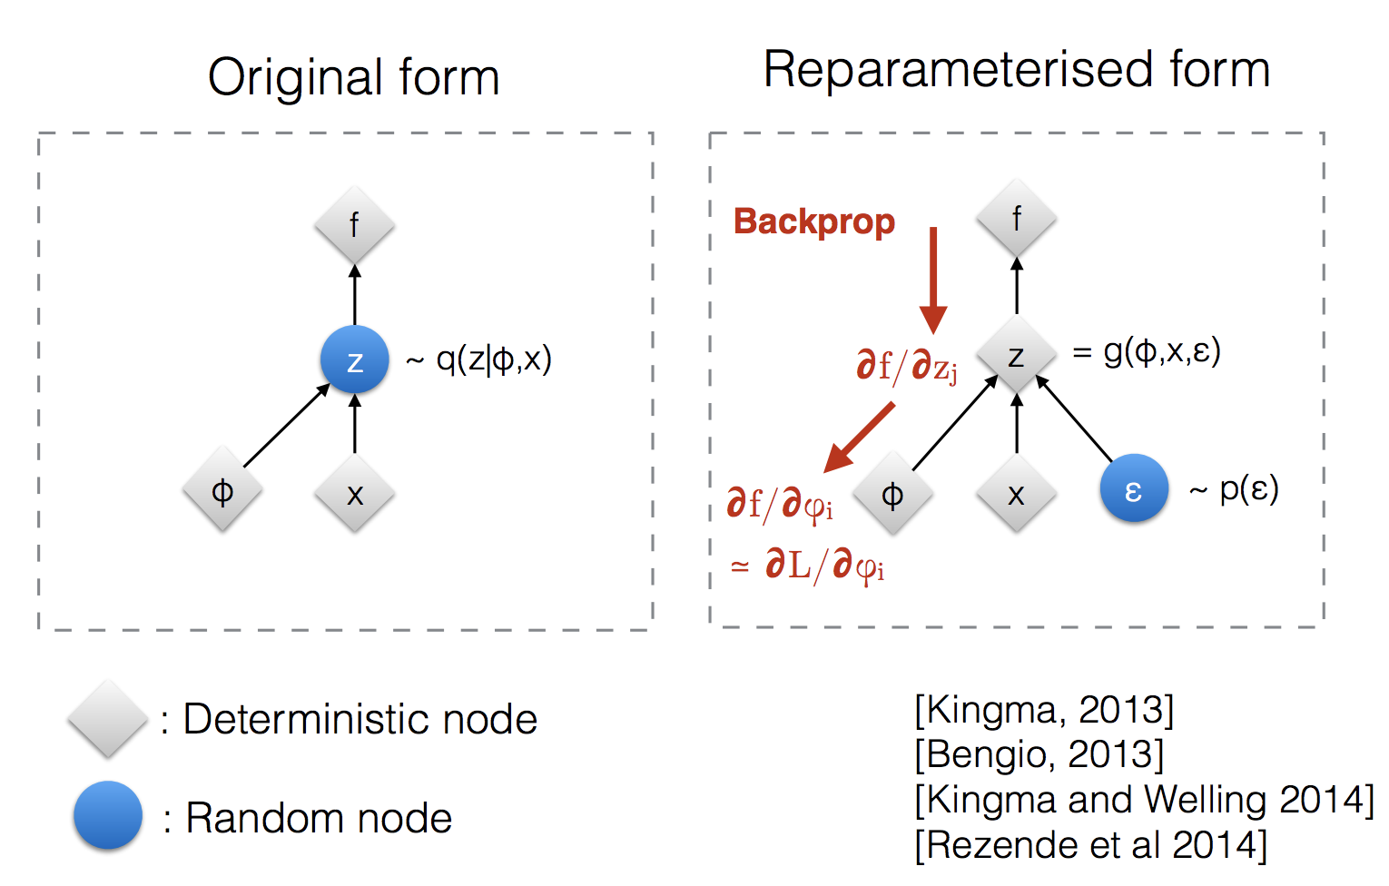
The Reparameterization Trick
Sampling is a stochastic process and therefore we cannot backpropagate the gradient. To make it trainable, the reparameterization trick is introduced.

Slide 14
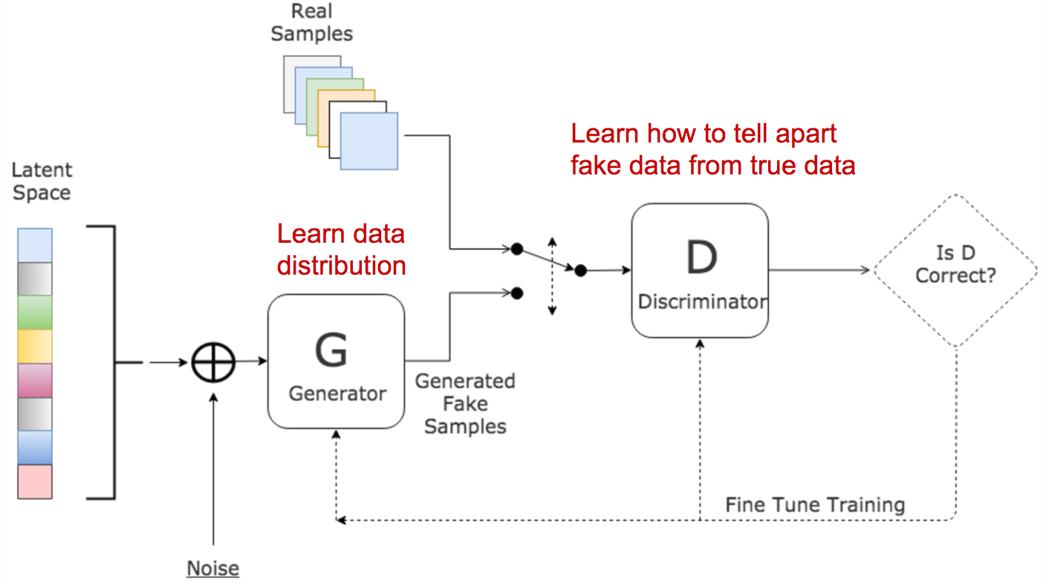
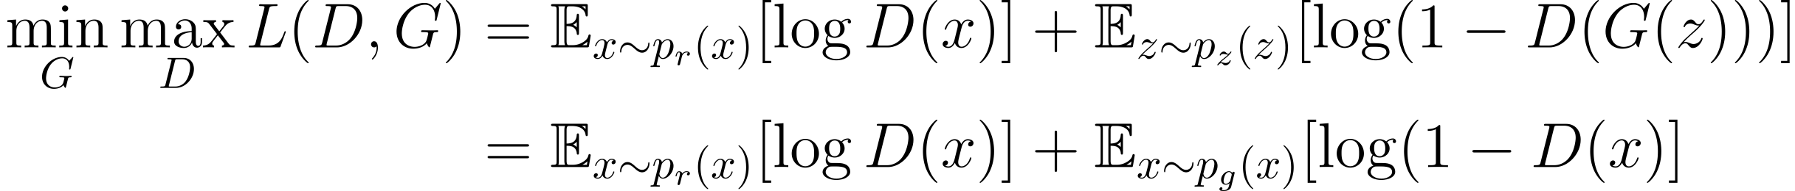

Generative Adversarial Network
Where $p_{r}$ is the distribution of real data $x$, $p_{z}$ is the distribution over noise $z$,
$p_{g}$ is the generator’s distribution over data $x$.

Slide 15
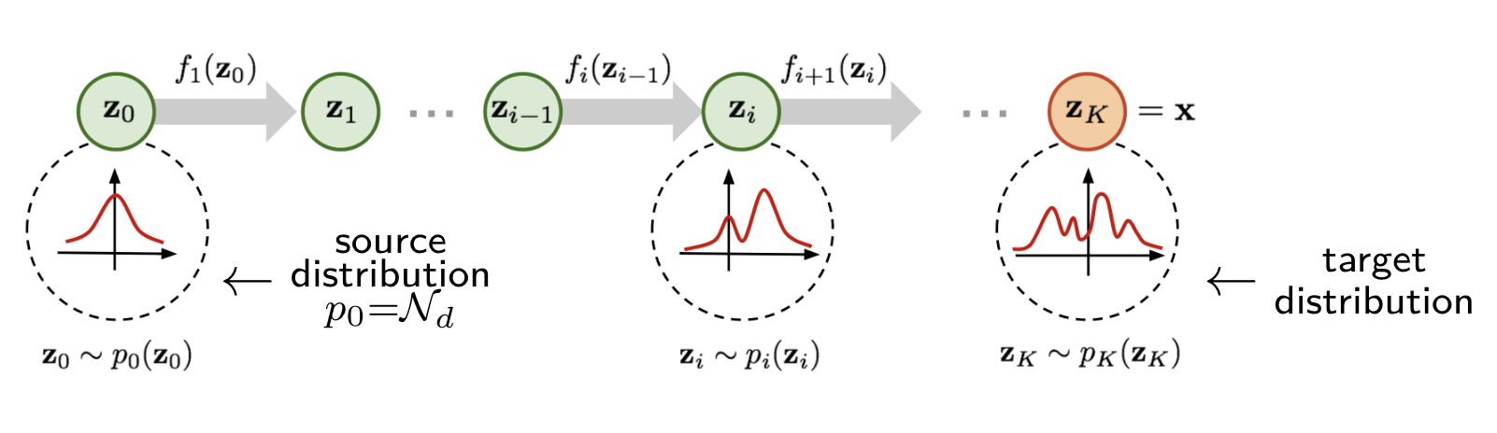
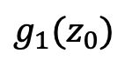


Flow-based Model
$$g_{1}(z_{0})$$
$$g_{i}(z_{i−1})$$
$$g_{i}(z_{i+1})$$
A Normalizing Flow (NF) model for better and more powerful distribution approximation. A normalizing flow transforms a simple distribution into a complex one by applying a sequence of invertible transformation functions to get the final target variable.

Slide 16
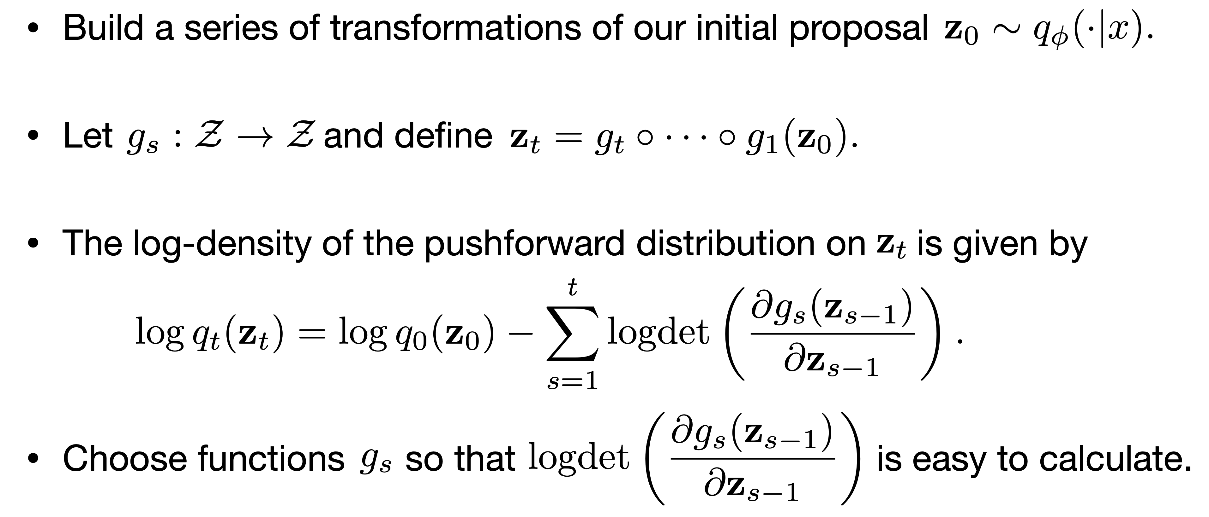
Normalizing Flows

Slide 17
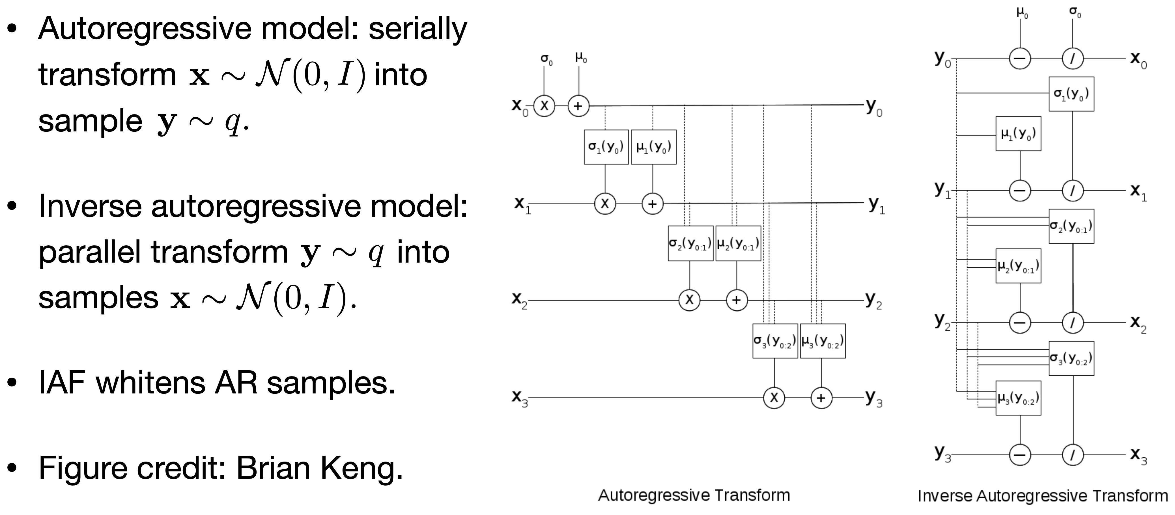
Inverse Autoregressive Flow (IAF)
(AR)
(IAF)

Slide 18
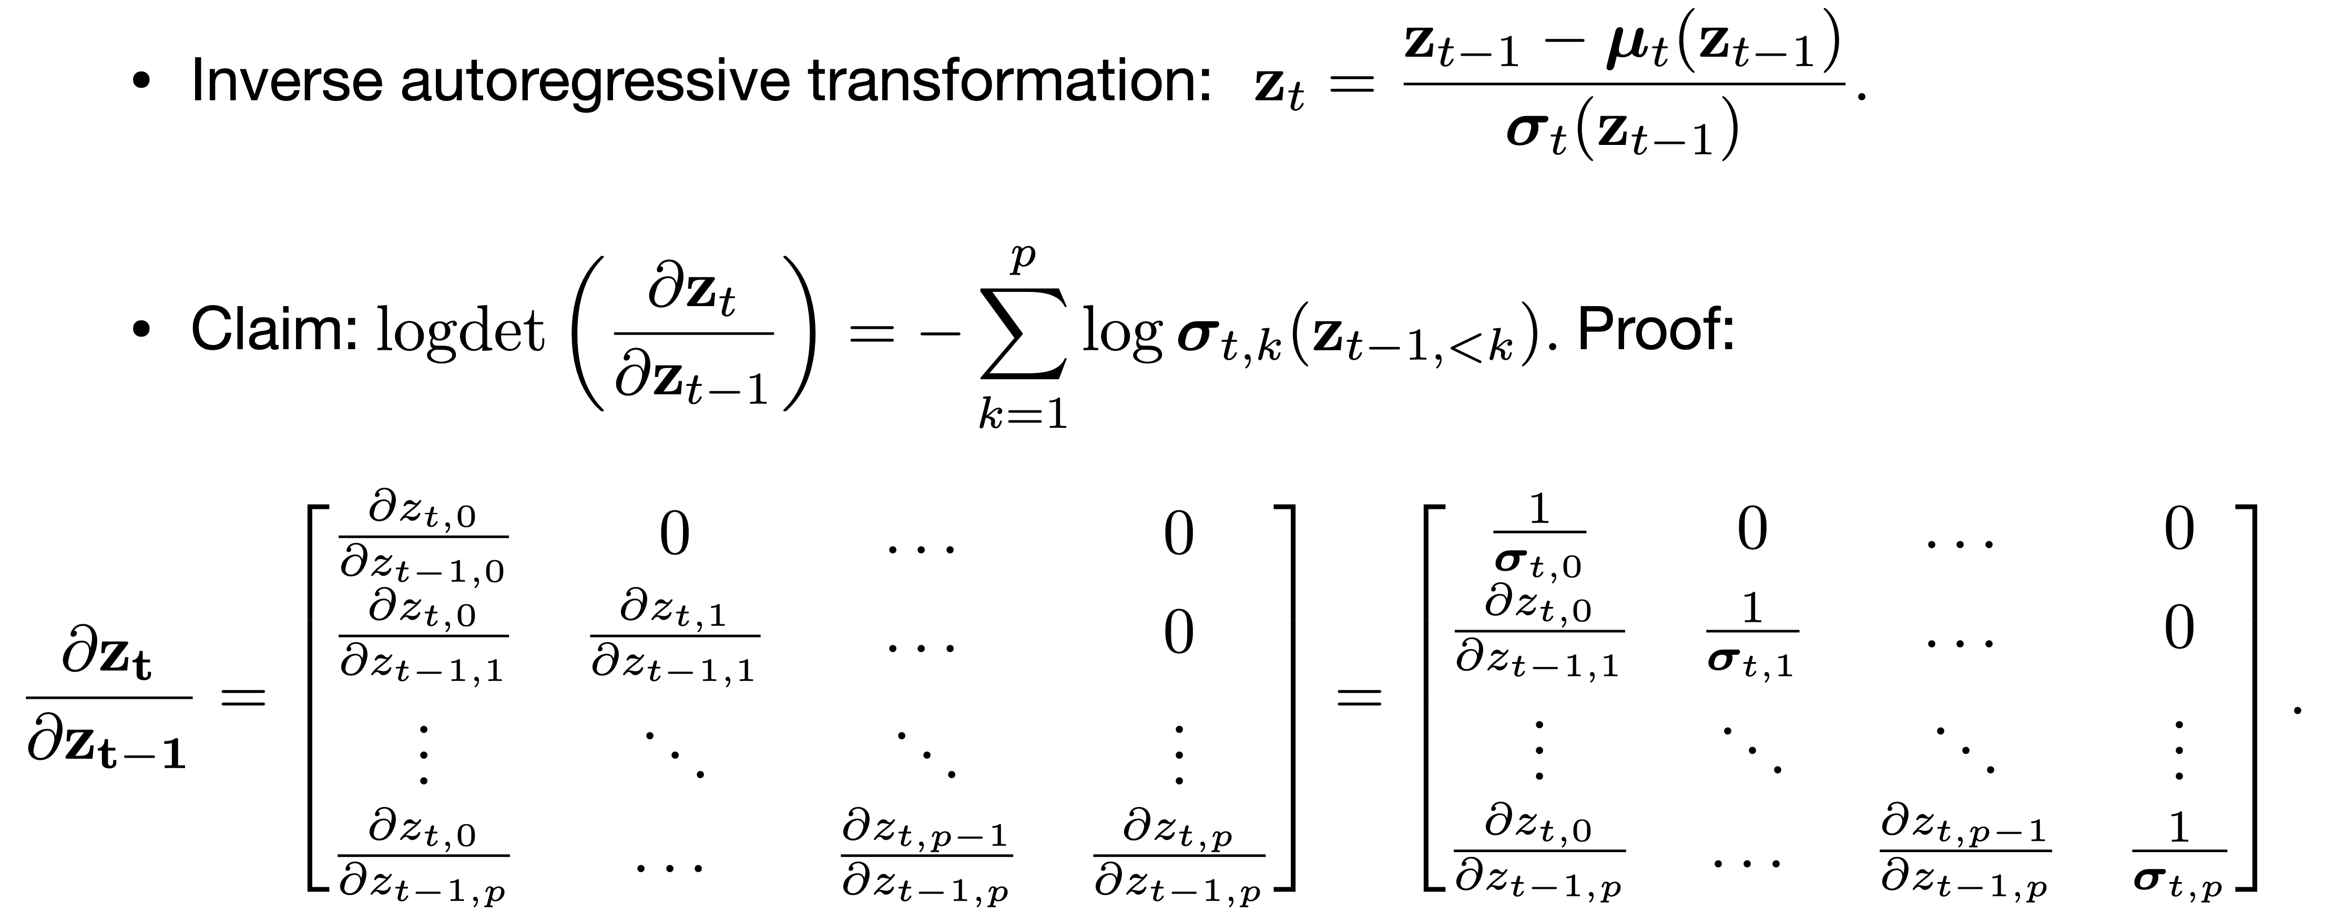
Inverse Autoregressive Flow (IAF)

Slide 19
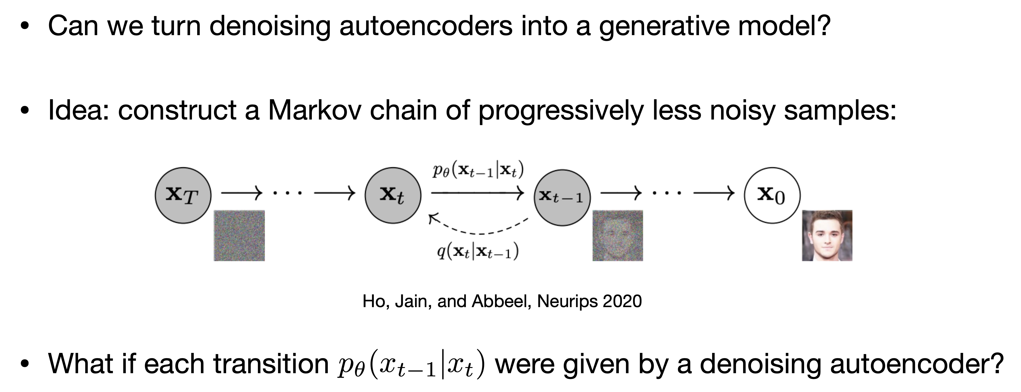
Generative Denoising AE

Slide 20
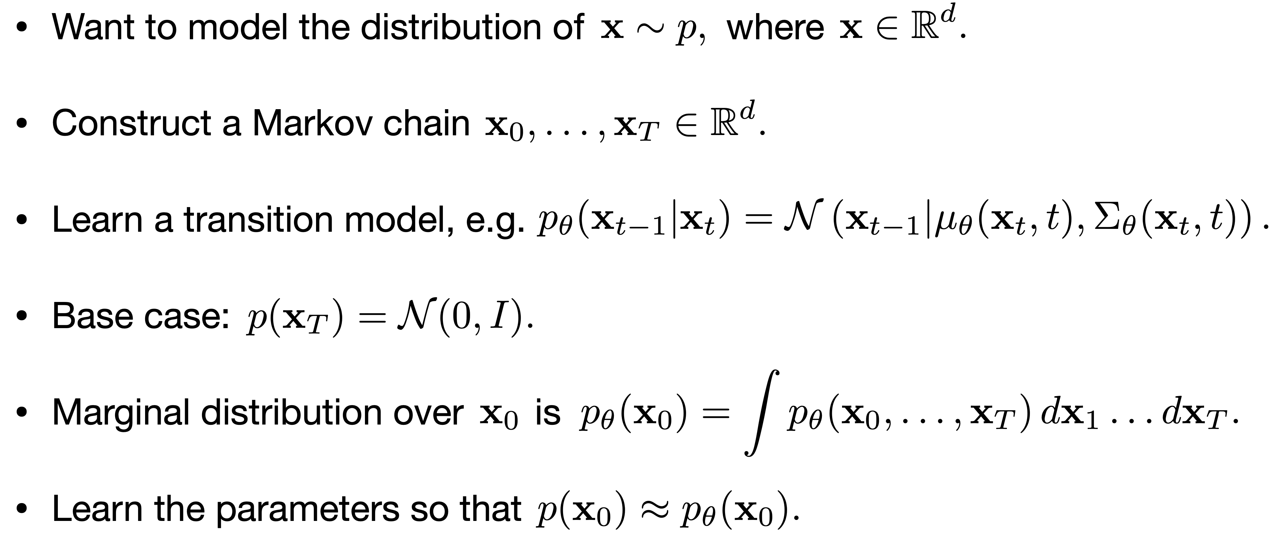
Diffusion Models

Slide 21
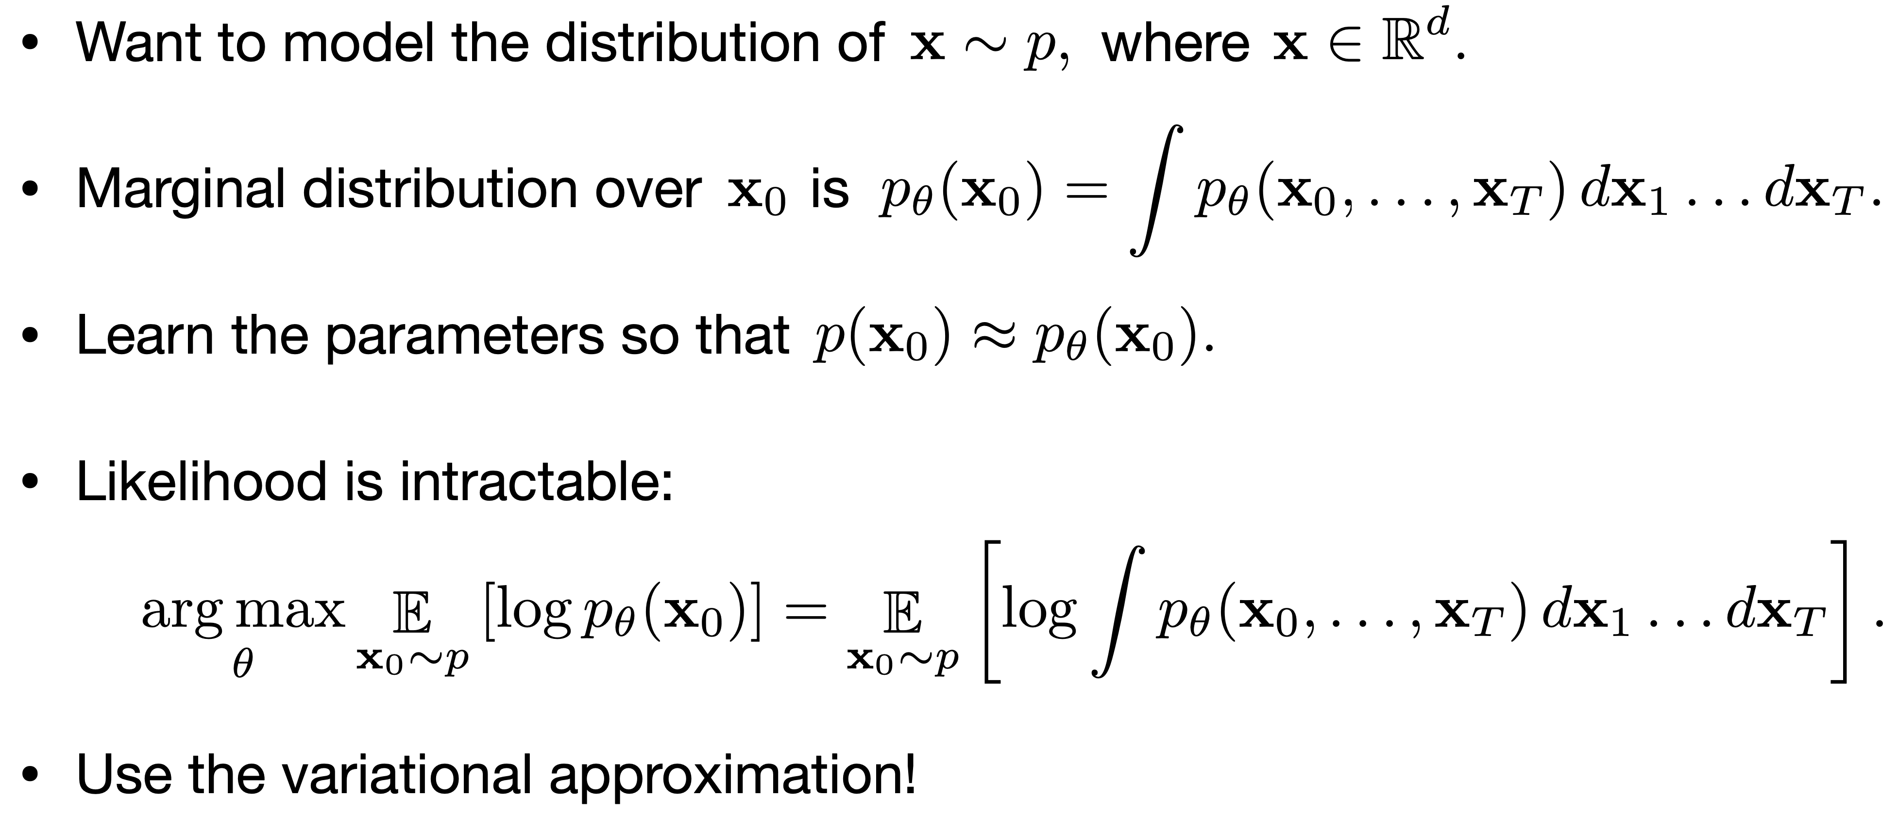
Maximize the Likelihood?
Estimate the gradient (score) directly!

Slide 22
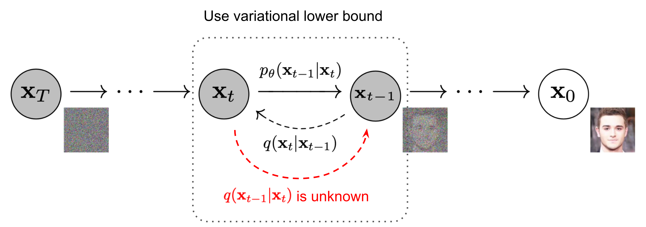
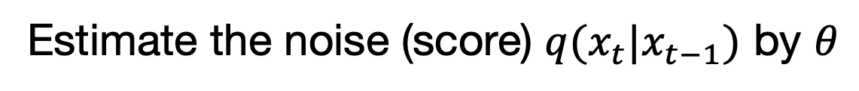
Score Matching
Estimate the noise (score) $q(x_{t}|x_{t−1})$ by $θ$

Slide 23
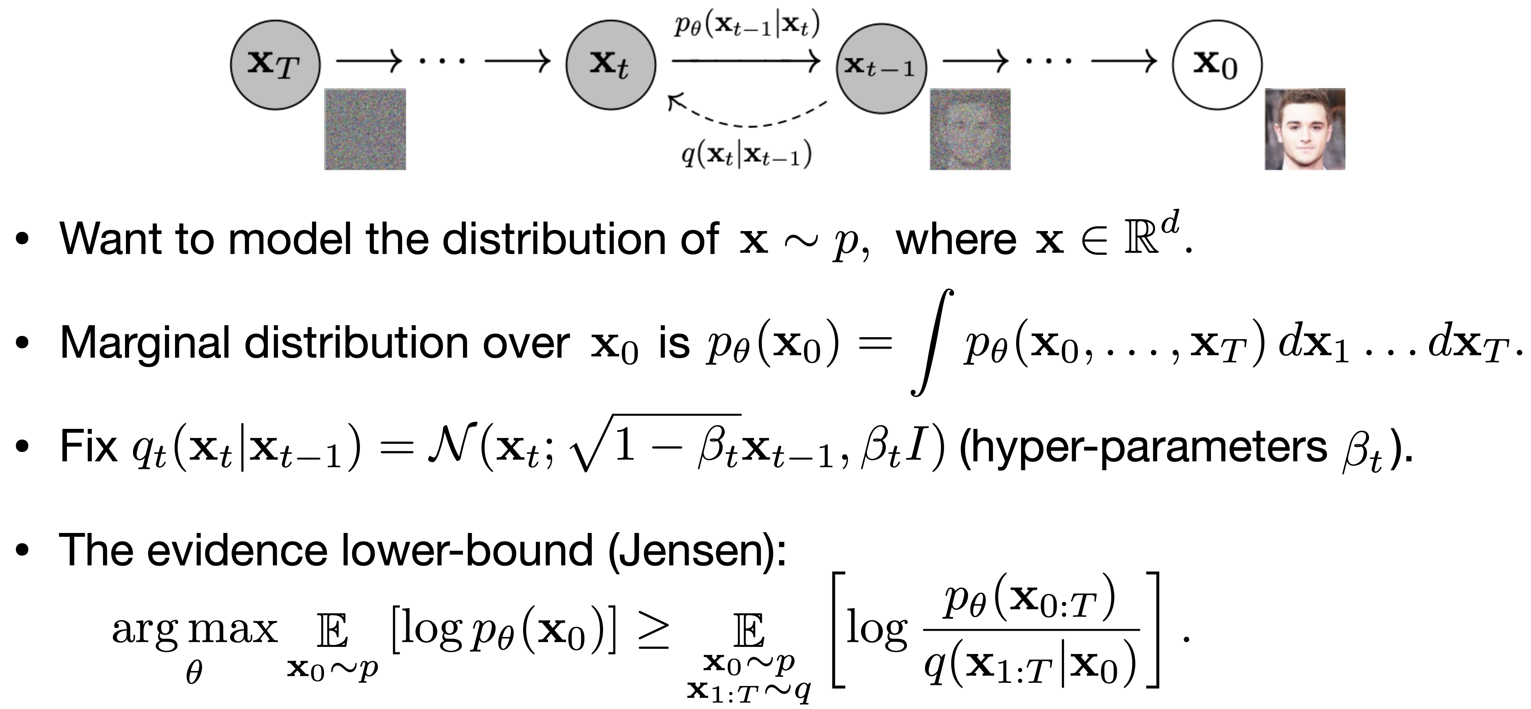
Posterior Approximation

Slide 24
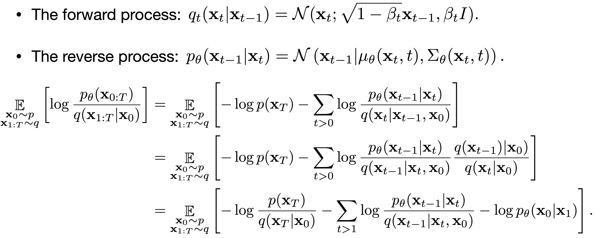
Unpacking the ELBO

Slide 25
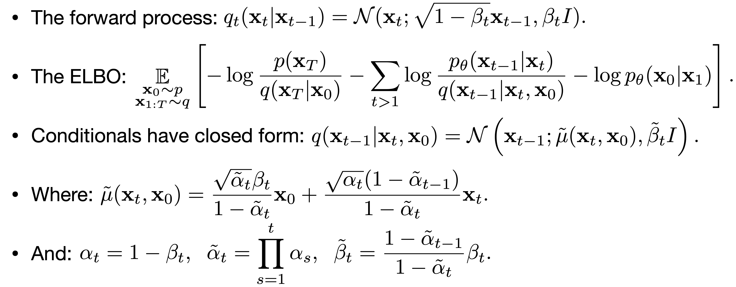
Closed Form Conditionals

Slide 26
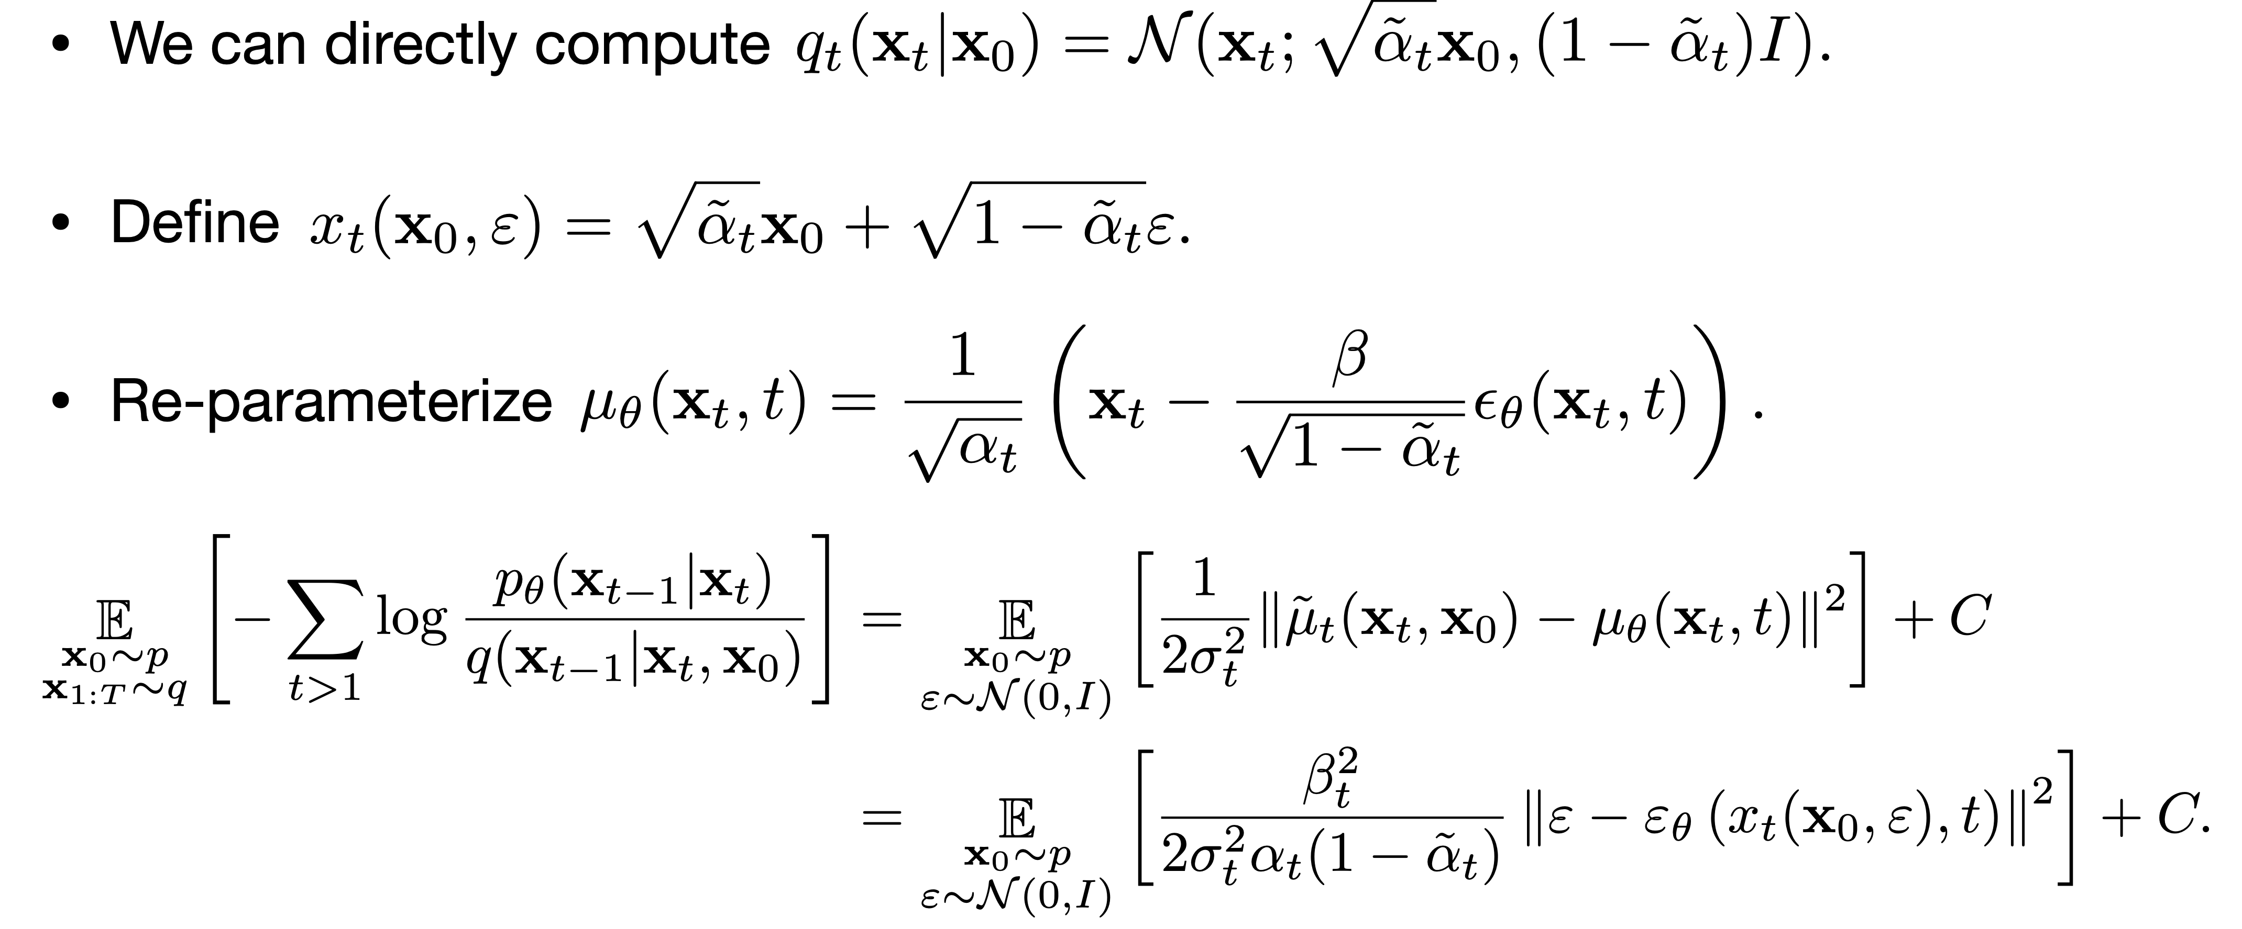
Reparameterization

Slide 27
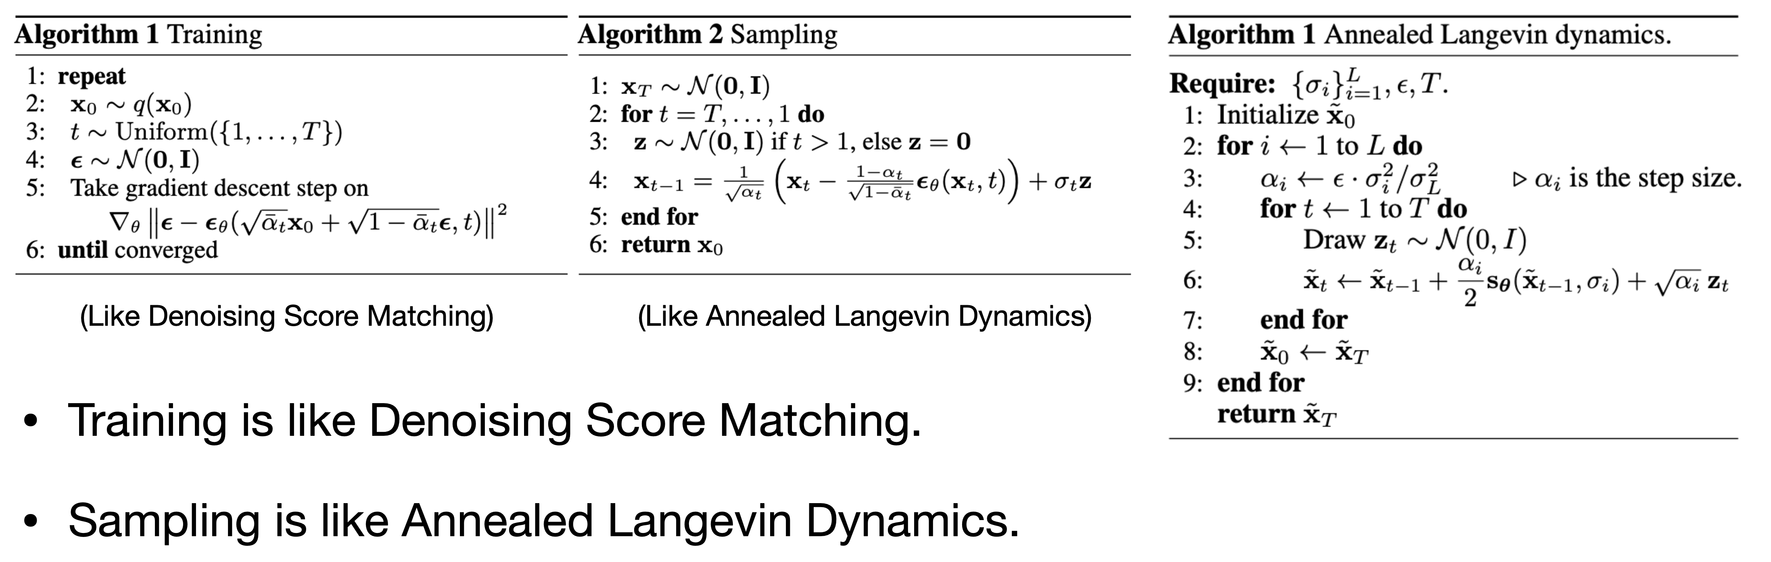
Analogies

